Slide 1
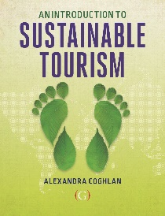
Change and innovation for sustainable tourism
Lecture 9
© Alexandra Coghlan 2019 Introduction to Sustainable Tourism

Slide 2
Sustainable tourism is about the future
To understand the future, you can either project from past trends, or use scenarios (but doesn’t account for disruptors).
- Past trends – a spectacular growth, geographic expansion and increasing economic dependency some regions
Scenarios – what is likely to happen based on trends in STEEP areas, and expert opinion
Disruptors, black swans,
© Alexandra Coghlan 2019 Introduction to Sustainable Tourism

Slide 3
Why is planning for change important?
Tourism relies on discretionary income and time
Involves a complex supply and distribution chain
Has many stakeholders at different levels
Is vulnerable to trends and events outside of its control
© Alexandra Coghlan 2019 Introduction to Sustainable Tourism

Slide 4
Understanding change
There are TWO main types of change:
1. Structural change
2. Temporary change, e.g. demand and supply cycles or crises/disasters (SARS, Boxing Day Tsunami)
Structural change can be gradual and sometimes hard to recognise…
“If you fail to plan, you plan to fail”
© Alexandra Coghlan 2019 Introduction to Sustainable Tourism

Slide 5
Structural change
Five areas where we might see structural change:
1. Social
2. Technological
3. Environmental
4. Economic
5. Political (and legal)
-> Innovation allows you to get ahead of change.
© Alexandra Coghlan 2019 Introduction to Sustainable Tourism

Slide 6
Tourism trends that affect growth
A STEEP approach
Social trends – e.g. growing middle class in emerging economies
Technological – e.g. ICT advances
Economic – e.g. growth of BRICS nations’ economies
Ecological – e.g. GHG emissions
Political – e.g. changes in border regulations
© Alexandra Coghlan 2019 Introduction to Sustainable Tourism

Slide 7
Ways of understanding change
Forecasting and Business as Usual approaches
Scenario-based planning: offers the chance to explore more complexity and uncertainty, presenting alternative, plausible futures.
Ask the expert – e.g. through a Delphi study, rounds of expert consultation, consolidation and confirmation of expert ideas.
© Alexandra Coghlan 2019 Introduction to Sustainable Tourism

Slide 8
© Alexandra Coghlan 2019 Introduction to Sustainable Tourism

Slide 9
Possible disruptors
a serious pandemic, where travel becomes personally risky and is highly regulated to prevent further spread of the biohazard,
a regional conflict in the Middle East that disrupts oil supplies,
another prolonged volcanic eruption that interrupts aviation routes,
abrupt climate change that leads to stricter GHG emissions regulations.
© Alexandra Coghlan 2019 Introduction to Sustainable Tourism

Slide 10
Scott and Gössling (2015) compare global risks vs tourism risks for next decade
© Alexandra Coghlan 2019 Introduction to Sustainable Tourism

Slide 11
Innovation
A way to meet the challenges of the future or just a buzzword?
Innovation is poorly developed in tourism
© Alexandra Coghlan 2019 Introduction to Sustainable Tourism

Slide 12
What is innovation?
Defined as the implementation of organisational learning, new ideas, new processes and products within an organisation
Is an indication of firm performance Ensures that the business keeps up with, or is ahead of, societal trends
More commonly applied to products than services
Can be in the form of ‘imitative’, ‘incremental’ and ‘discontinuous’ to ‘really new’ and ‘radically innovative’
Ensures that the business keeps up with, or is ahead of, societal trends
© Alexandra Coghlan 2019 Introduction to Sustainable Tourism

Slide 13
Four types of innovation
Product or service: new & observable to customer
Process: back of house efficiency operating systems
Marketing: communication with customers
Managerial: aimed at staff satisfaction
© Alexandra Coghlan 2019 Introduction to Sustainable Tourism
Notes:
e.g. of marketing = loyalty programs

Slide 14
Sustainability-oriented innovations
© Alexandra Coghlan 2019 Introduction to Sustainable Tourism

Slide 15
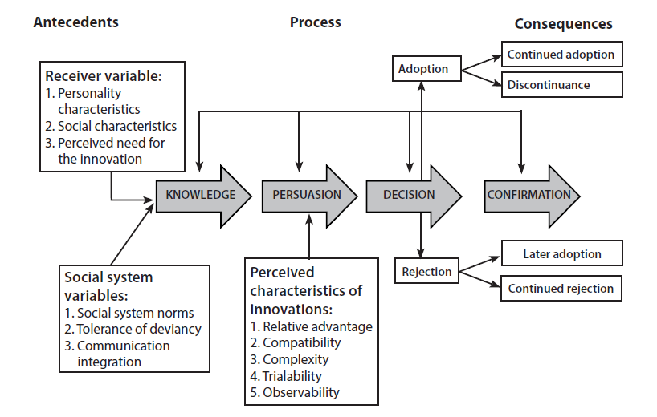
The adoption of innovation
Rogers’ diffusion of innovations model
Five attributes required for successful market diffusion for innovation:
1. relative advantage,
2. status (social kudos),
3. compatibility,
4. complexity (too complex is a negative) and
5. trialability.
© Alexandra Coghlan 2019 Introduction to Sustainable Tourism

Slide 16
Vs the non-adoption of innovation
Innovation characteristics
Value barrier
Usage barrier
Image barrier
Risk barrier
Consumer inertia (personality)
Resistance to change (personality)
Behavioural constraints
Switching costs
Sunk costs
Habit
Awareness
© Alexandra Coghlan 2019 Introduction to Sustainable Tourism

Slide 17
Smart tourism (and Artificial Intel)
Combines sensors, big data, open data, new ways of connectivity and exchange of information (e.g., Internet of Things, RFID, and NFC) as well as abilities to infer and reason.
Fuzzy concept that is poorly defined but BUZZWORD
and often applied to sustainability, e.g.
(i) Barcelona’s interactive bus shelters provide touristic information and bus arrival times but also USB ports for charging mobile devices.
(ii) Brisbane has over 100 beacons at PoIs to communicate information to tourists via a mobile app if they are within a certain radius of the location
(iii) Amsterdam uses beacons to let tourist signs translate themselves into different languages and the Amsterdam ArenA is testing sensors for better crowd management
© Alexandra Coghlan 2019 Introduction to Sustainable Tourism

Slide 18
VR & AR
Augmented Reality – usually used with location devices, collect rewards as part of tour (Pokemon Go), access extra information about an attraction or destination, or represent features that are not physically present anymore
Virtual reality – represents a destination or attraction at prepurchase stage, allow you to “sample” destination; recreates artefacts that either no longer exist or can’t be shown; creates narratives of a place; Opens up opportunities for travellers with mobility issues or destinations that are not accessible
© Alexandra Coghlan 2019 Introduction to Sustainable Tourism

Slide 19
The shared economy
Also “peer-to-peer” or “collaborative economy”
Brings together online, mobile, and social.
Appeals to search for authenticity and local encounters.
Used for accommodation, transport, meals.
Legitimacy? Quality? Safety?
© Alexandra Coghlan 2019 Introduction to Sustainable Tourism

Slide 20
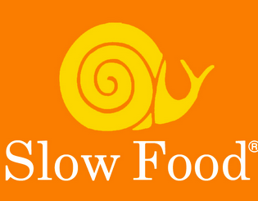
Response to innovations: The Slow Movement
Response to fast pace modern living
Applies to food, travel, cities, schools, money
Aims for connection,
wellbeing & community
BIOREGIONALISM
vs
GLOBALISATION

